Slide 1
STEP 5 – GATHERING DATA
Round up all those bits and bytes…

Slide 2
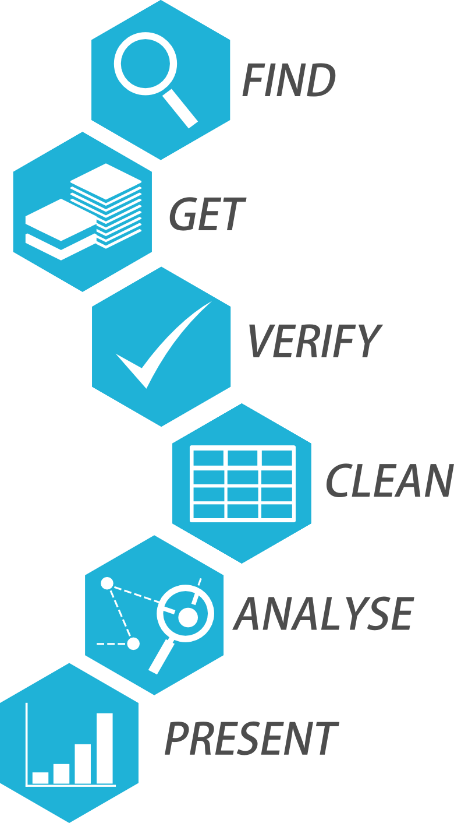
Step 5 Collate All Your Data
Our app is going to contain static and dynamic data
Static data doesn’t change
Dynamic data can and will change
At this stage of the project we only need to worry about collecting static data

Slide 3
Step 5 Collate All Your Data
This maps our field id’s with our text
E.g. LoginText -> Login
Static and dynamic data can be combined
E.g. ParcelStatusText -> Your parcel is due on {date} at {time}
Dynamic data denoted in braces {}
We may need to plan to add additional languages
This is less important for a personal project but can be crucial when working on a commercial project
Best way to do this is to construct a spreadsheet
But this can be a word doc, database etc.

Slide 4
CHALLENGE TIME!
Collate your own set of static data for your application
You can do this in any format, but you must have a field id and some text to match
For bonus points, try combining static data with a piece of data that would be dynamic
Check my example in the resources if you need to
Share your results with us all on the Slack boards!

